Slide 1
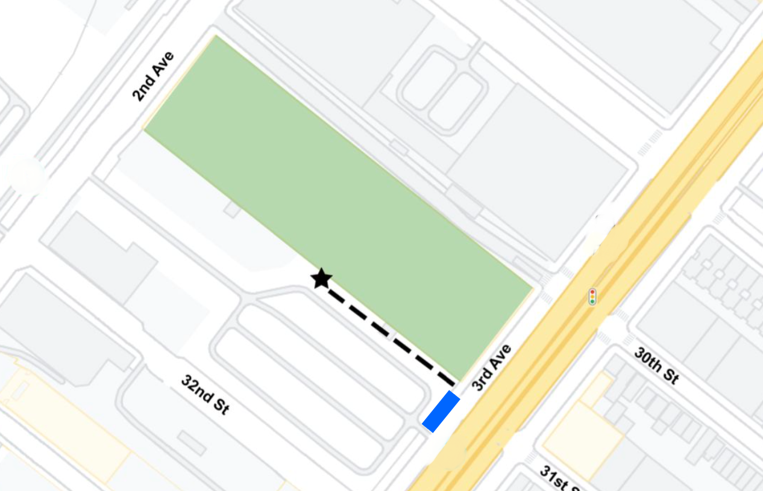
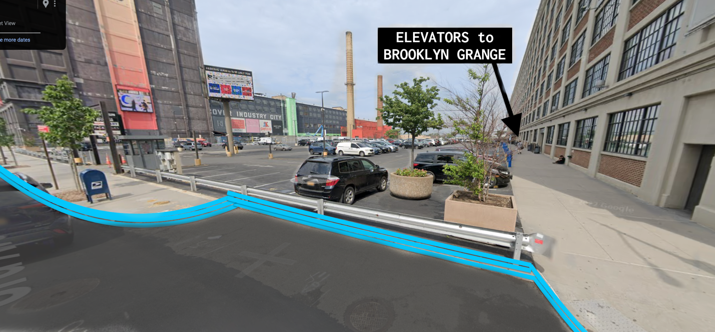
SUNSET PARK
850 3rd Avenue (at 31st St)
Brooklyn, NY 11232
Brooklyn Grange operates multiple rooftop farm locations. Make sure you're headed to the right one!
END-OF-NIGHT PICKUP FOR VALET or SHUTTLE BUSSES
- Car / bus inlet where the building’s sidewalk meets 3rd Avenue, highlighted in blue

